Slide 1

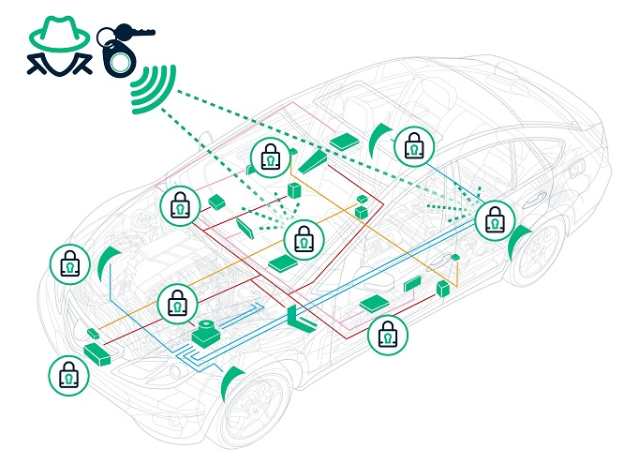


Watch out your Car
Key Fobs Security
😈
by : Mohamed salah-el-den
Senior staff engineer in research and technical solutions department
📧 meldin@tra.gov.eg

Slide 2
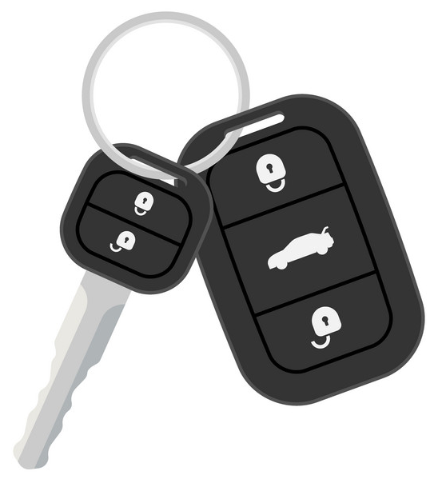
Agenda
Access control in cars
What are Key fobs
How key fob works
Hacking key fobs
Steal some cars

Slide 3

Disclaimer
Please note that this session is for educational purposes only, I hold no responsibility for any unexpected car disappearances in Egypt. Let's keep the learning light-hearted and the cars where they belong!.
😅😅😅

Slide 4
Introduction to Car locking system What, Why and Wow Key Fobs Work
Mohamed salah-el-den

Slide 5
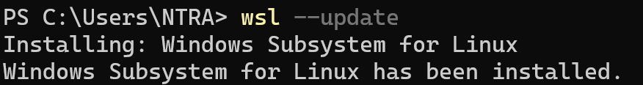
Car locking system
Mohamed salah-el-den

Slide 6
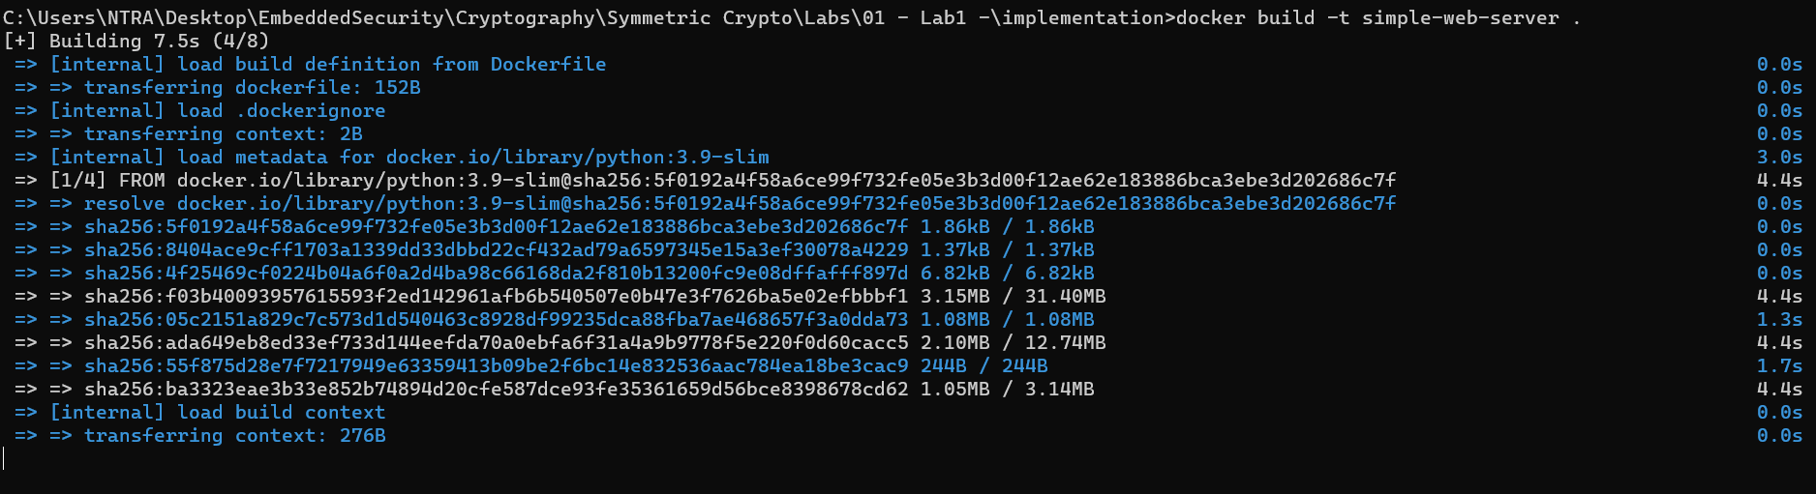
Car locking system
Mohamed salah-el-den

Slide 7
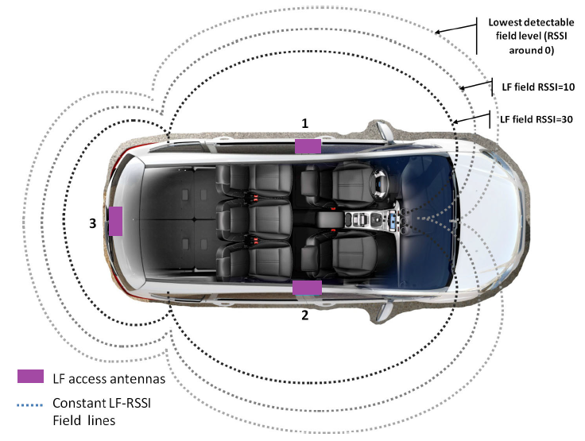
LF access antennas
Mohamed salah-el-den

Slide 8
What is Key Fobs
Key fobs offers security and access control for various devices.
also known as keyless entry remotes or keyless entry systems
operate through radio frequency technology.
This signal is received by the car receiver which then grants access or performs a specific action
Key fobs have become a standard feature in modern vehicles.

Slide 9
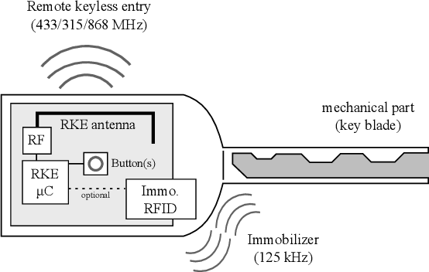
Key Fobs internals
Key Fob includes this parts
Processing and RF generation chip
Antenna
Buttons
When the key is pressed the processing chip generates a code corresponding to the button being pressed
Each button has its own code
The code is then modulates a radio frequency carrier wave to be sent over wireless channel

Slide 10
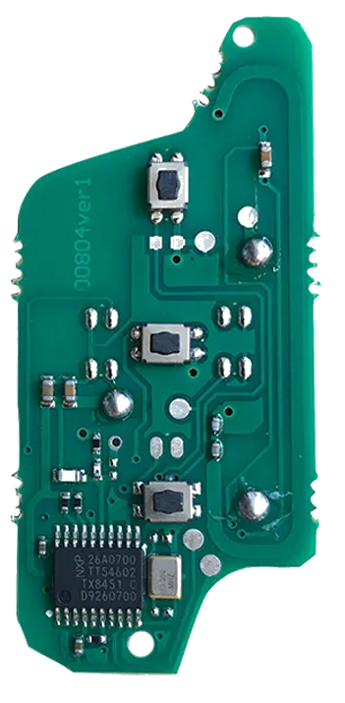

What is Key Fobs
The radio frequency of the carrier ranges from
315MHz in U.S. and Japan +/- 2.5 MHz
433.92MHz in Europe
To detect the exact frequency of the device is operating at we can use FCC ID information of we can use SDR

Slide 11
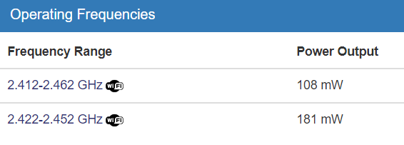
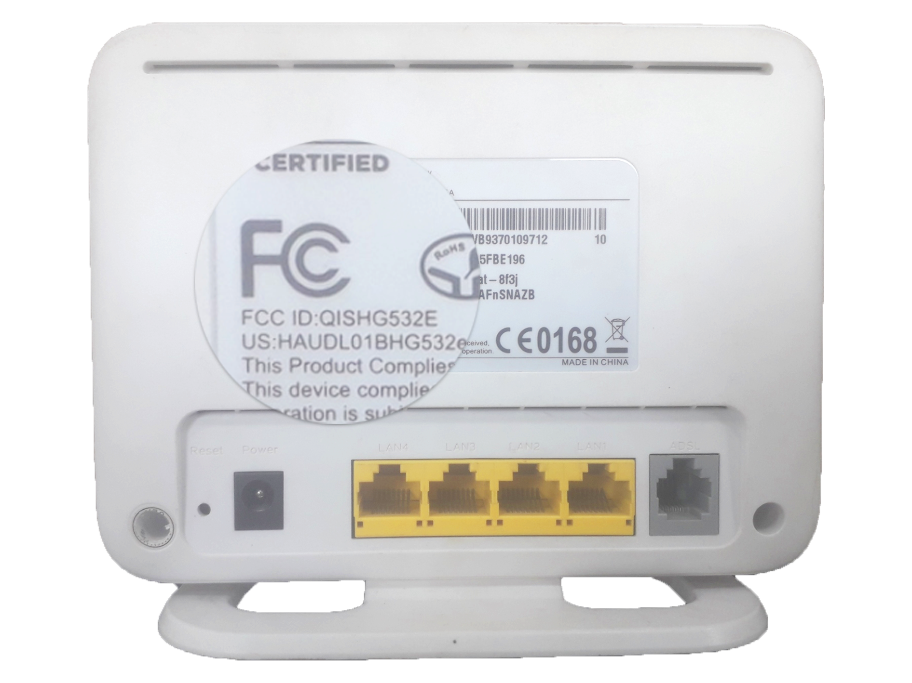
FCC ID
If the device is approved by FCC search by the device ID to get the internals Most of the time you will find a document labeled internal photos
Get the datasheet from the vendor’s website view all the vendor’s logo from here
FCC ID Search
Search Results | Federal Communications Commission (fcc.gov)

Slide 12
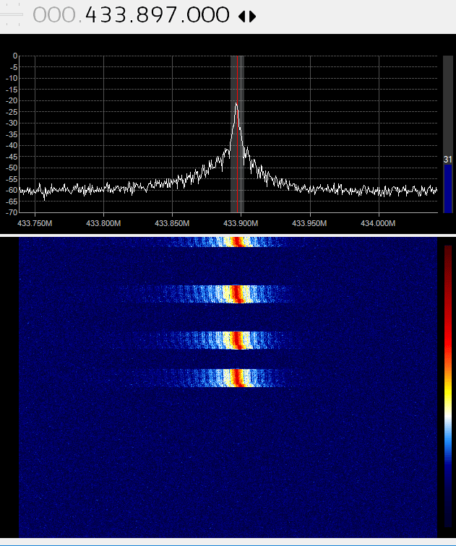
SDR Scan
SDR or software defined radio is a device which can be programmed to match unique Radio application specifications
This is done by changing the receiving radio frequency, analysing it and transmit it again
It can be used to detect the frequency range of keyfobs

Slide 13
lets get the frequency range of some remotes
Mohamed salah-el-den

Slide 14
How to send data over wireless RF frequency and modulation
Mohamed salah-el-den

Slide 15
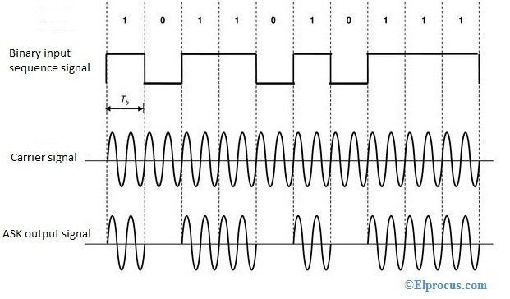
Digital Data over wireless
To send the code over wireless channel we need to modulate the carrier frequency with the digital values of the code
This can be done through various ways
Amplitude shift key also known as OOK
Frequency shift key FSK
Phase shift key

Slide 16
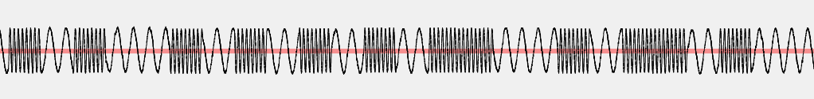
Common Key fobs modulation
Frequency shift key “FSK” changes the frequency based on the code being sent (0 for low frequency and 1 for high frequency)
On Off key “OOK” turn on or off the RF signal based on the code being sent (0 for no frequency and 1 for RF frequency exist)

Slide 17
Let’s see what modulation scheme do we use on SDR
Mohamed salah-el-den

Slide 18
What if we jam the signal ?!
Mohamed salah-el-den

Slide 19
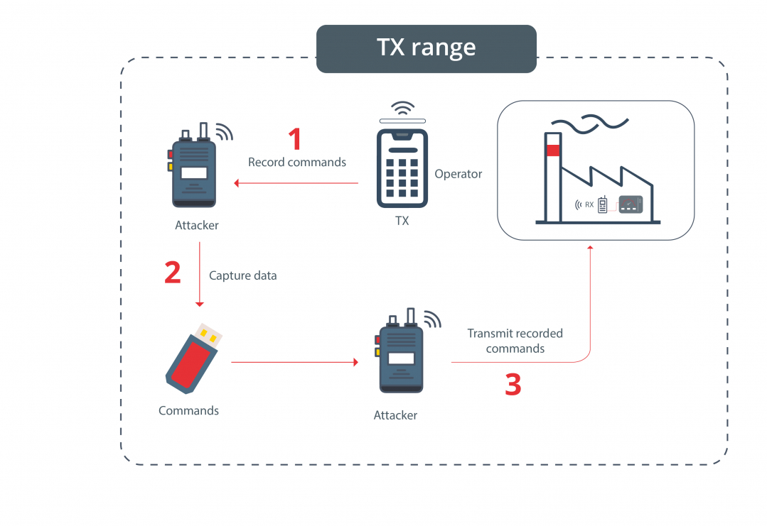
Replay attack
One of the most common attacks on RF devices are relay attacks
Attackers use specialized devices to intercept and amplify the signal between a key fob and a vehicle, tricking the car into thinking the fob is nearby and gaining unauthorized access.

Slide 20
Let’s Replay
Mohamed salah-el-den

Slide 21
Key Fobs Code types How key fob generates codes
Mohamed salah-el-den

Slide 22
Key fob code
Key fobs generates a code every time the button is pressed
Each key fob sends it’s unique code
The code can be one of the following types
Fixed code authentication
Rolling code authentication
Challenge response authentication
Key ID | Button ID
Fixed Key fob Code architecture

Slide 23
Fixed code Key fobs
In fixed code key fob, the key stores only one Code and each time the user press the unlock button the fixed code is sent to the car
Different buttons have different code
Lock button pressed 4 times

Slide 24
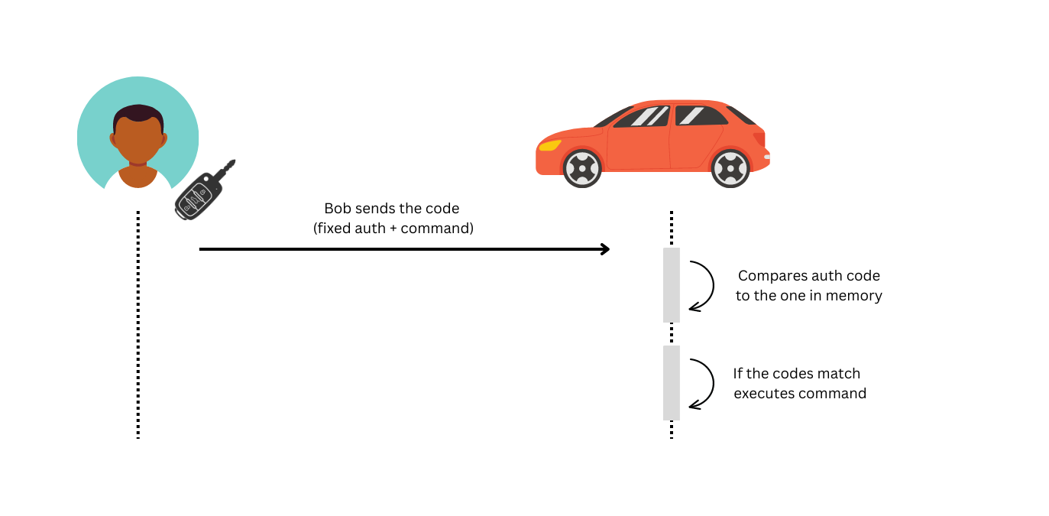
Fixed code authentication

Slide 25
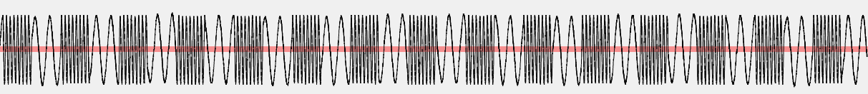
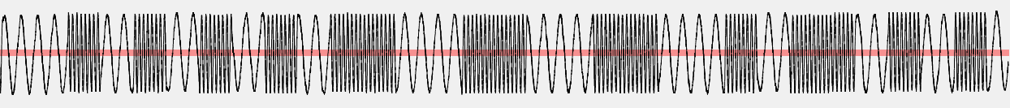
Rolling code Key fobs
In rolling code key fob, the code generator generates a new code each time the button is pressed
New codes makes the old codes deprecated for the car
If car listens to old code it doesn’t respond
Lock button pressed 4 times

Slide 26
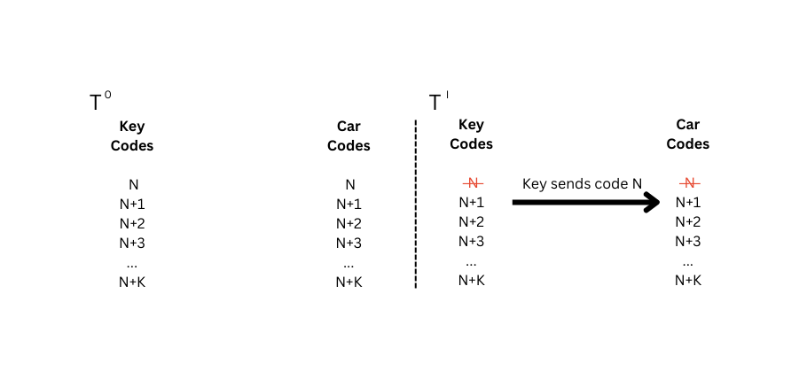
Rolling codes list
Both the car and the key have codes list
If the code is used the code is removed from the list and can not be used any more
This will mitigate the replay attacks
Key ID | Counter | Button ID
Rolling Key fob Code architecture

Slide 27
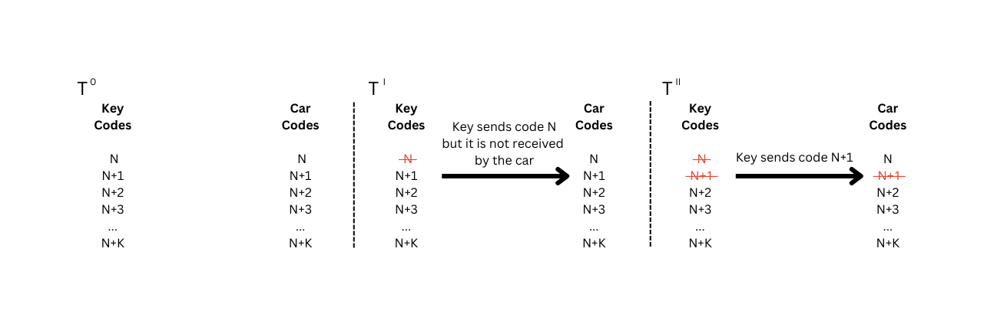
Rolling codes list
Once the car listen to N+1, the N code in the list cannot be used even if it want listened by the car

Slide 28
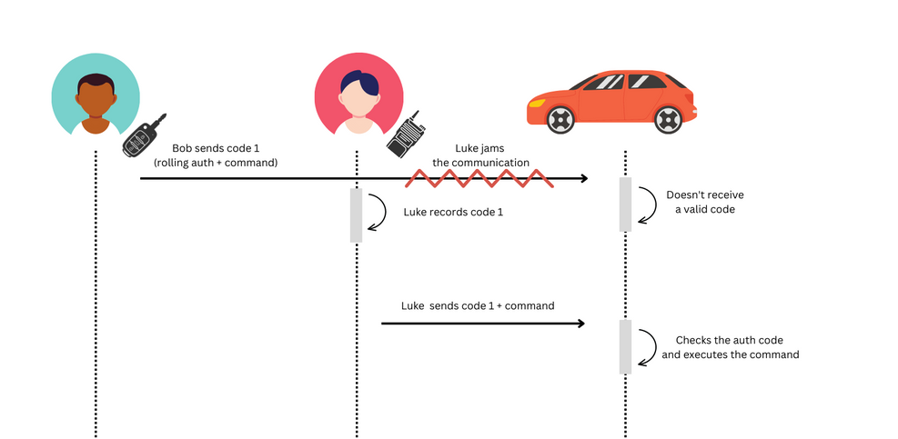
RollJam Attack

Slide 29
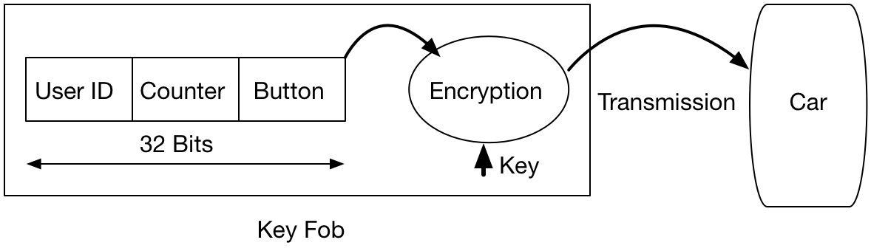
Let’s increase the security
We add an encryption to the code
The code is now encrypted at the key fob and then decrypted at the car
If the decryption was true and the counter is increased from the last time the car listen to the counter the car unlocks

Slide 30
Does encryption adds any security ?
Mohamed salah-el-den

Slide 31
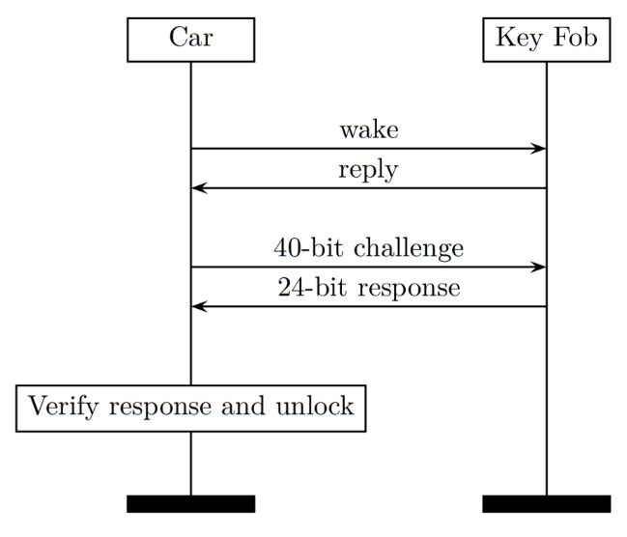
Challenge response keyfob
In the challenge response key fob the car sends a new code every time the key fob user press the button
The key fob encrypt the transmitted challenge and resend it to the car
The car decrypt the response and if the decrypted message matches the transmitted challenge, the car opens

Slide 32
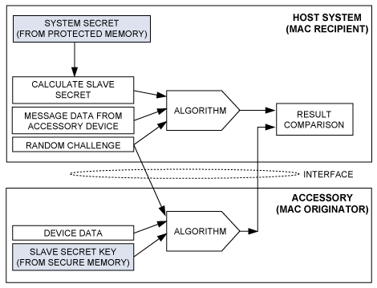
Challenge response key fob

Slide 33
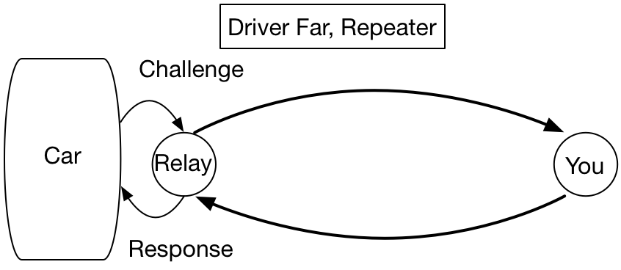
Relay attack
attackers use specialized devices to intercept and amplify the signal between a key fob and a vehicle, tricking the car into thinking the fob is nearby and gaining unauthorized access.

Slide 34
Let’s steal some one’s car Just for learning
😇
Don’t try this at home, ……ummm, or you can try it but you don’t have the SDR device due to regulations
😎

Slide 35

Thank you

